Slide 1
Earth, Moon and Sun

Slide 2
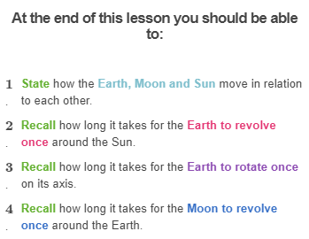

Slide 3
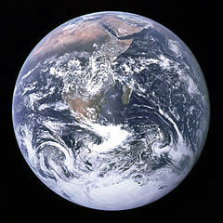
Earth is the planet we all live on. This is what Earth looks like from space:

Slide 4
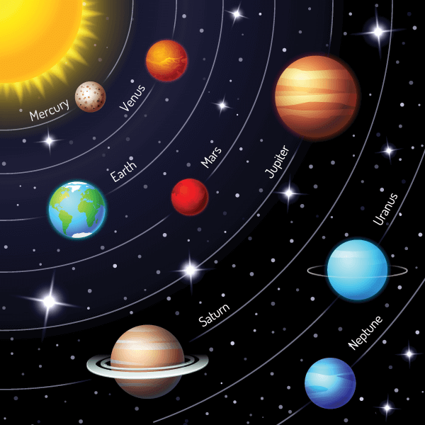
Earth is the third planet from the Sun in our solar system.
All of the planets in our solar system orbit around the Sun. Earth orbits between Venus and Mars.

Slide 5
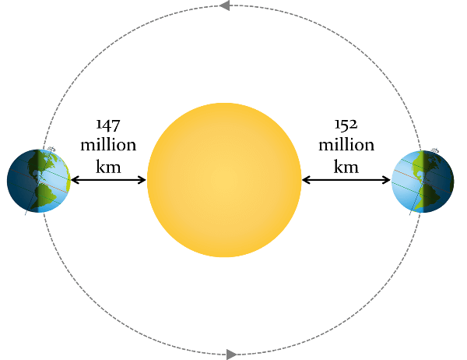
Earth orbits around the Sun in a slightly elliptical orbit, with the Sun at one of the focal points.
At its aphelion (furthest distance from the Sun), Earth is 152 million kilometres from the Sun, and at its perihelion (closest distance to the Sun), Earth is 147 million kilometres from the Sun.
This puts Earth in the middle of the habitable zone:

Slide 6
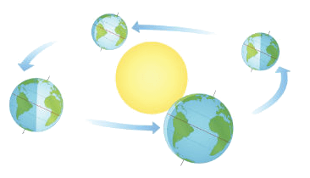
The Earth’s orbit is its path around the Sun.
It takes the Earth 365 1/4 days to completely orbit the Sun.
This is called one revolution, and it is the length of one year.

Slide 7
However, on our calendars, we don't see 1/4 of a day!
In order to simplify the calendar, we make each year have 365 days, with every fourth year having 366 days (leap years).
The extra day occurs on February 29th.
If you average the number of days over four years, you get 365 1/4 days per year.

Slide 8
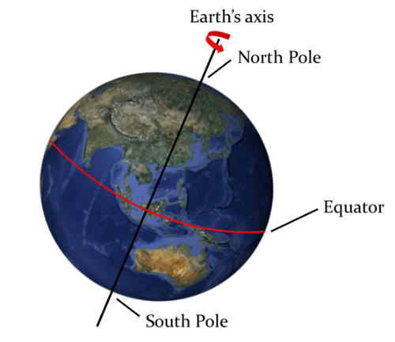
An imaginary line called the axis runs through the Earth from the North Pole to the South Pole.
Earth rotates around this line from west to east.
Exactly halfway between the North Pole and South Pole is a line called the equator.

Slide 9
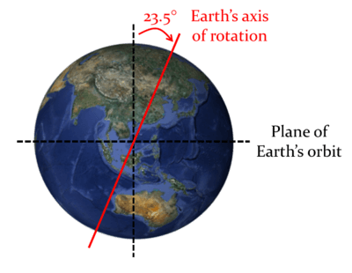
The Earth's axis of rotation.
The Earth's axis of rotation is tilted on an angle of 23.5∘ from vertical compared to its plane of orbit around the Sun.
This is a very important part of what causes different day lengths and the different seasons!

Slide 10
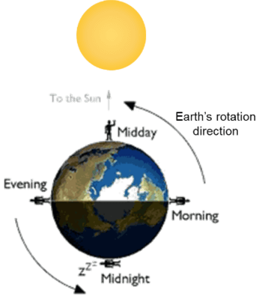
The time taken for any planet to rotate about its axis is referred to as a day.
Earth takes 24 hours to complete a full rotation, therefore one day on Earth is 24 hours.
If it was midnight in Australia right now, the time taken for Earth to complete one full rotation and come back to midnight again is 24 hours.

Slide 11
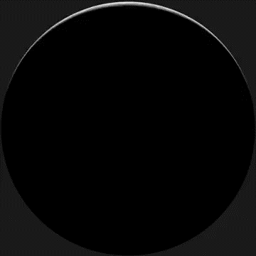
At any time, the half of Earth facing the Sun is bathed in sunlight.
This half of Earth experiences daytime. The other half is in the dark and so experiences nighttime. As the Earth rotates, some countries move into the light while others move out of it.

Slide 12
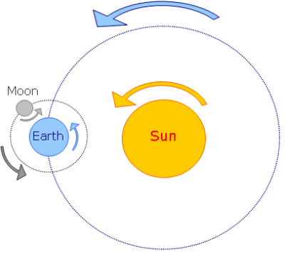
As the Earth orbits the Sun, the Moon orbits the Earth.
It takes 27.3 days for the moon to complete a revolution (an orbit) around the Earth.
However, the time between full moons is 29.5 days. The reason that the moon cycle takes an extra couple of days is because the Earth has moved in its own orbit around the Sun in that time. Therefore, it takes the Moon just a little bit longer to reach the same point in the sky relative to the Earth.

Slide 13
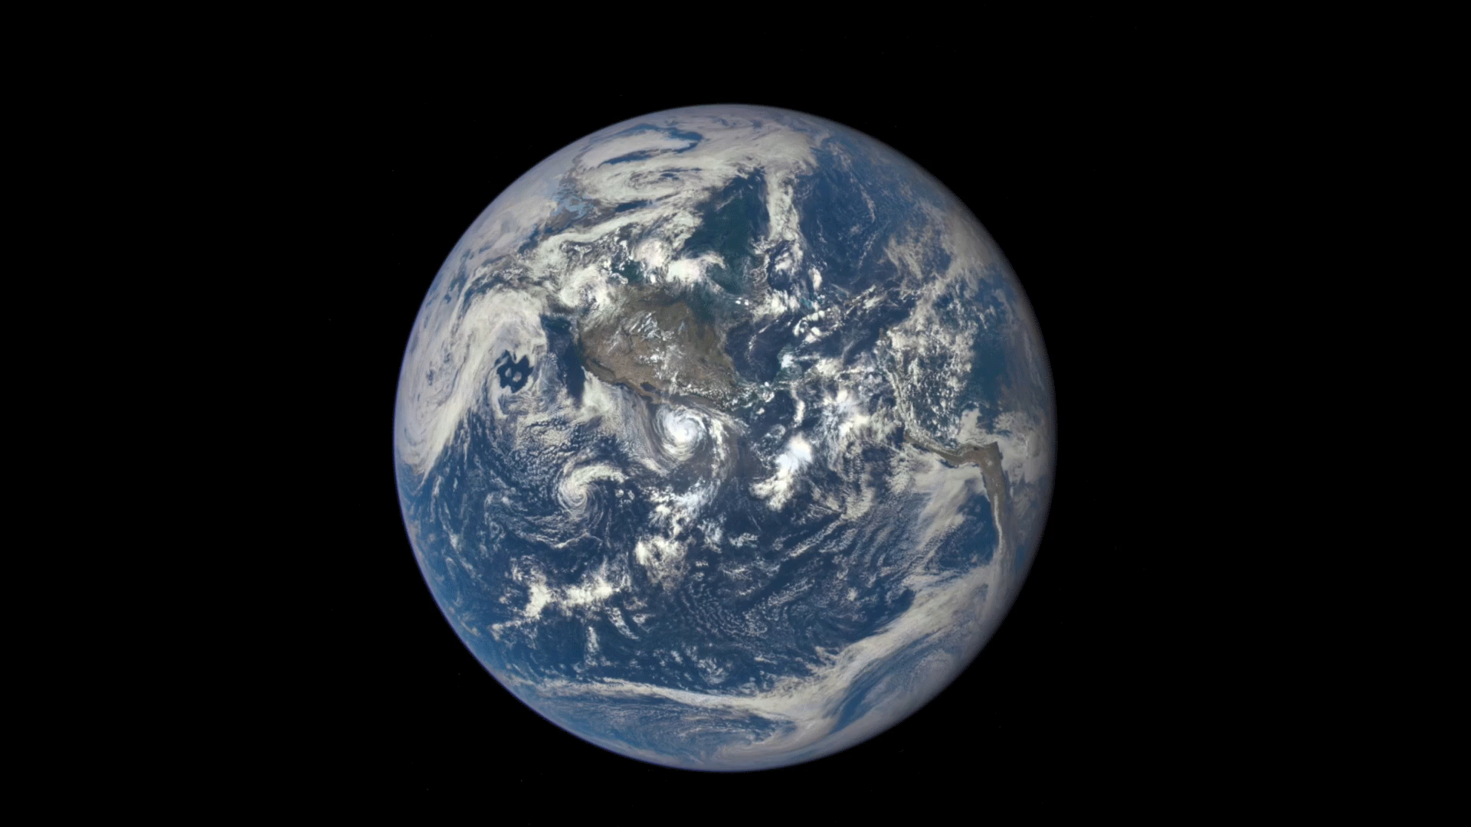
The Moon rotates on its axis as it revolves around the Earth.
The time it takes for the Moon to rotate once on its axis is also 27.3 days, which is the same time that it takes for the Moon to revolve around the Earth! Because the rotation period is the same as the revolution period, the same side of the Moon remains facing us.

Slide 14
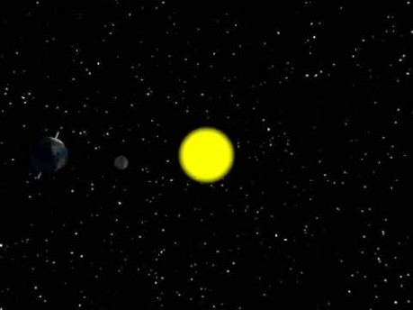

Slide 15
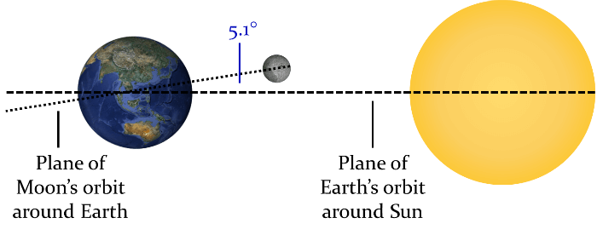
The plane of the Moon's orbit around the Earth is tilted on an angle of 5.1° compared to the plane of the Earth's orbit around the Sun.

